Slide 1

Crop Yield Prediction using Machine Learning
Guided By:
Mr. Anay Tamhankar
Mr. Prasad Deshmukh
Submitted By:
Pradnya Bhosale (220343025009)
Neha Ghadage (220343025010)
Shrikant Shingne (220343025045)
Hitesh Upare (220343025052)
27/08/2023
1

Slide 2
Introduction
In the contemporary world where agriculture plays pivotal role in ensuring food security and sustainability. The utilization of advanced technologies is becoming increasingly crucial. One such technology has the potential to revolutionize the agriculture sector by enhancing predictive capabilities and informed decision making.
Our project seeks to get the data driven insights aiding farmers , policy makers and stake holders in making strategic choices for more productive and resilient agricultural landscape.

Slide 3
Use of Crop Production and Rainfall data.
Dataset period from 2000 to 2014.
There are more than 2040000 observations.
Data size is 19mb.

Slide 4
Outline
Introduction
Problem Statement
Project Methodology
Data Pre-Processing
Machine Learning Algorithms
Data Visualization & Representation
Conclusion
4

Slide 5
Problem Statement
The goal is to provide farmers with reliable information about potential crop yield before planting, allowing them to make informed decisions about resource allocation and crop selection.

Slide 6
Project Methodology
Data Study and Data Cleaning
Crop Production & Rainfall
Data Transformation
Data Blending
Linear Regression
Decision Tree
Random Forest
Machine Learning Algorithm
Data Visualization
Plots using Tableau

Slide 7
Data Pre-Processing :-
1) Cleaning the columns according to requirement
2) Converting target columns into binary values
3) Dropping missing values
4) Merging the two data frames
5) Encoding of Categorical Columns
6

Slide 8
Machine Learning Algorithms
Linear Regression-
Linear regression algorithm shows a linear relationship between a dependent (y) and one or more independent (y) variables, hence called as linear regression.
2) KNN Regression–
For regression, KNN calculates the average of the target values of the K nearest neighbors and uses this average as the predicted value for the new data point.
3) Random Forest –
The Random Forest (RF) regressor is an ensemble learning method based on multiple decision trees. By combining the Bootstrap aggregating and random space method, RF overcomes the drawbacks of individual decision tree.

Slide 9
ACCURACY OBTAINED BY DIFFERENT ALGORITHMS
ALGORITHM USED FOR MODEL | R2 SCORE OBTAINED
Linear Regression | For crop:0.8241 For State:0.4432
KNN Regression | For crop:0.8458 For state:-0.0353
Random Forests | For crop:0.8981 For state:0.8652

Slide 10
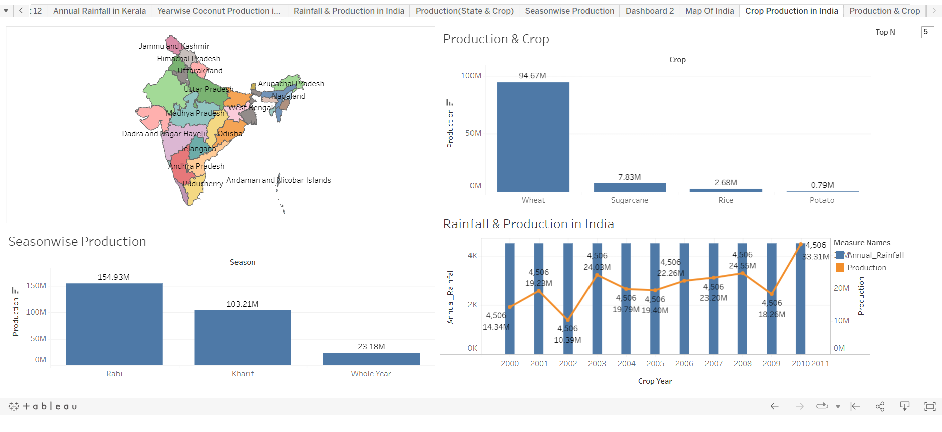
Data Visualization & Representation

Slide 11
CONCLUSION AND FUTURE SCOPE
After analyzing and modeling the merged dataset of crop-production and rainfall, we can conclude that machine learning can be effectively used in predicting yield of crop.
The linear regression model achieved an r2_score of around 0.8241, while the Random Forest Regressor model achieved r2_score of around 0.8981 and KNN regressor achieved r2_score of around 0.8458
For future scope, if we get the proper data of weather and soil type etc. from all the states of India then we can make crop-recommendation model which will tell farmers which crop they should grow in their fields.
From Data Visualization:
1.Rice
Production is mostly depends on Season, Area, State(place).
2.cocunut
Production is directly proportional to area.
Its production is also gradually increasing over a time of period.
Production is high in Kerala state.
It does not depend on season.

Slide 12
3.Sugarcane Production is directly proportional to area. And the production is high in some state only.

Slide 13
Thank you….

